Slide 1
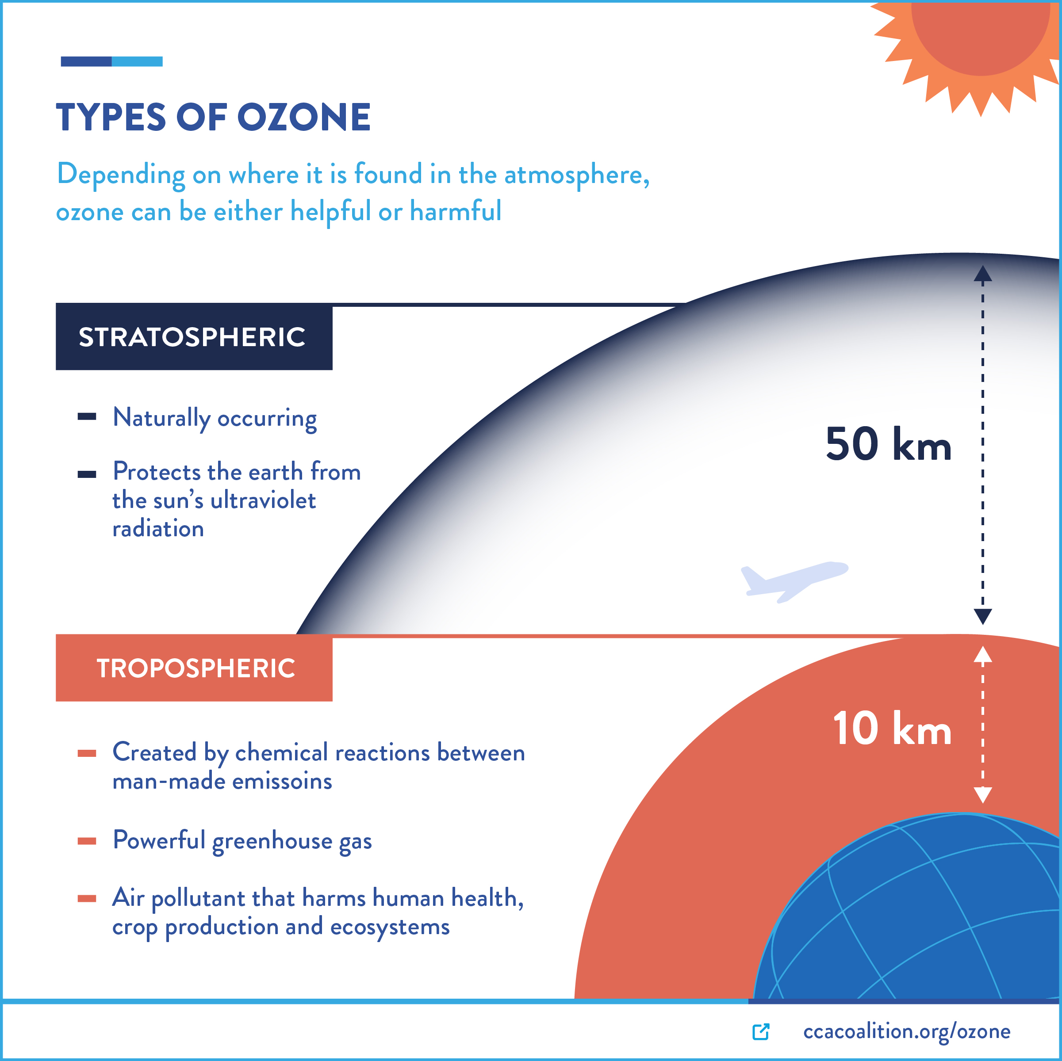
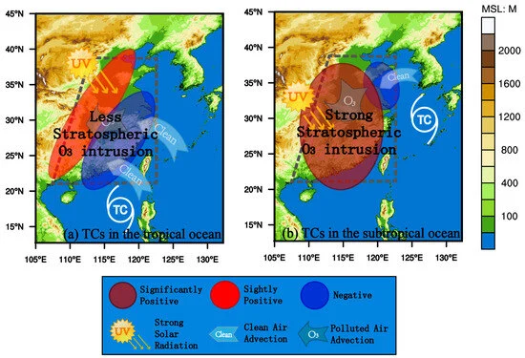
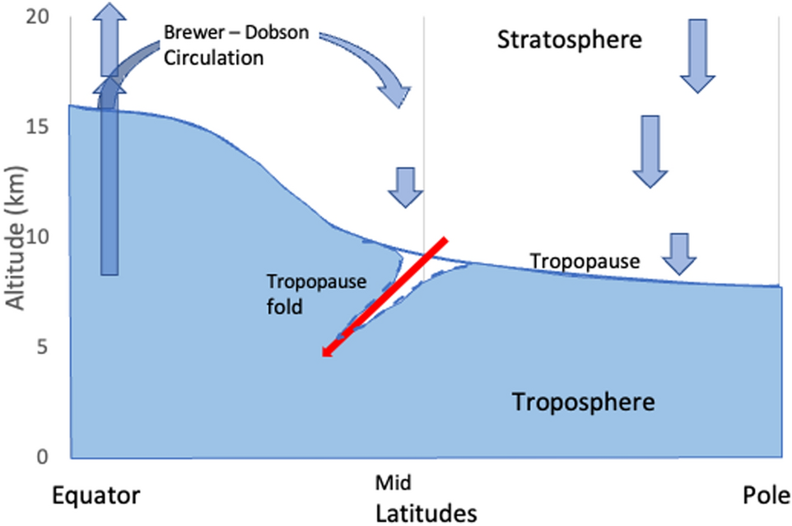
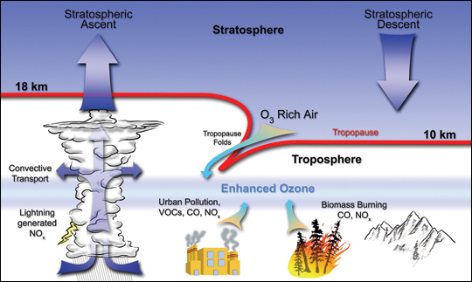
Understanding the Impact of Stratosphere-Troposphere Exchange on Ozone Distribution and Climate Dynamics
Surat Dewan, Anita Lakhani
Department of Chemistry, Dayalbagh Educational Institute, Dayalbagh, Agra-282005, UP, India
Email-suratdewan@gmail.com, anita.lakhani01@gmail.com
Introduction
Ozone is one of the most significant trace gases in the atmosphere. It is a strong oxidant, a short-lived climate forcer, and an important greenhouse gas. About 10% of the total atmospheric ozone column resides in the troposphere and 90% in the stratosphere. In the stratosphere, ozone plays an important role in protecting us from harmful ultraviolet radiation. However, in the troposphere, ozone is a pollutant that is detrimental to human health, crops, and ecosystems.
Figure 1: The ozone layer in the stratosphere absorbs UV light, protecting life on Earth from its harmful effects but in the troposphere is an air pollutant. ( Image-www.ccacoalition.org)
The tropospheric ozone budget is controlled by chemical production and loss, by stratospheric–tropospheric exchange (STE), and by deposition at the Earth’s surface,
The stratosphere has long been acknowledged as a significant contributor to tropospheric ozone.
Stratosphere-to-troposphere transport refers to the movement of air and ozone from the stratosphere across the tropopause into the troposphere.
Meul et al., 2018 have projected a 53% increase in the global mean annual influx of stratospheric ozone into the troposphere between the years 2000 and 2100.
The 380K isentropic surface of the extratropic is a key boundary for quantifying the global annual downward flux of ozone into the troposphere.
STE is driven by the large-scale stratospheric meridional circulation known as Brewer-Dobson circulation (BDC).
In the tropics, air rises from the troposphere to the stratosphere and this air is then transported to the extratropical stratosphere.
Finally, it descends from the stratosphere to the troposphere at high and middle latitudes.
Figure 2: Sources of tropospheric ozone and STE through tropopause folds. (Image- earthobservatory.nasa.gov)
BDC is expected to intensify in a warming future, which is estimated to lead to:
A 3% increase in surface ozone and a 6% increase in mid-tropospheric ozone.
Abalos et al., 2020 have reported a 10–16% increase in stratospheric ozone in the troposphere by the end of the 21st century due to the strengthening of the BDC.
Studies also indicate tropical cyclones lead to intrusion of stratospheric air into the troposphere. The tropospheric stability is weakened due to overshooting convection associated with tropical cyclones and plays a key role in STE. Das et al. observed an increase in surface ozone levels by ~ 10 ppbv in the daytime and 10–15 ppbv in the night-time during a cyclone. They also report the descent rate of the enhanced ozone layer during the passage of the tropical cyclone to be 0.8–1kmday⁻¹, which is three times that of a clear-sky day. The increase in the upper-tropospheric (10–16 km) ozone was 20–50 ppbv, which stretched down to the middle (6–10 km) and lower troposphere.
Figure 4: A diagram of the TCs in (a) the tropical and (b) subtropical Northwest Pacific affecting the near-surface O₃ significantly positive (brown circle), slightly positive (red circle) and negative anomalies (blue circle) over China, and the meteorological mechanisms identified with vertical transport of stratospheric O₃ intrusion, strong solar radiation for photochemical O₃ production and clean (polluted) air advection for O₃ horizontal transport in the lower troposphere. ( Image- Jiang et al., 2024)
Knowland et al., 2017 examined the influence of mid-latitude cyclones on European background surface ozone influence. They identified the importance of the passage of a cyclone’s cold front, the ability of cyclones to bring down high levels of O₃ from the stratosphere, and associated surface high-pressure systems as the main drivers associated with cyclones that impact surface ozone.
Jiang et al. observed downward transport of stratospheric O₃ of tropical cyclones in the subtropical ocean exerts a large impact on the atmospheric environment over China, while the regional O₃ transport and photochemical productions dominate the lower troposphere over China with less impact of stratospheric intrusion from the TCs in the tropical ocean region.
Table 1:Recent estimates of the ozone burden as estimated by different models. (IPCC,2021)
STE increases tropospheric ozone levels, enhancing the greenhouse effect and contributing to global warming.
Changes in the vertical distribution of ozone and other trace gases due to STE alter radiative forcing and atmospheric chemical reactions, impacting climate dynamics.
Changes in STE can also affect regional precipitation patterns. For example, increased tropospheric ozone and related changes in atmospheric stability can influence cloud formation and precipitation, potentially leading to altered rainfall patterns.
STE influences climate feedback mechanisms and weather patterns, including jet stream dynamics and atmospheric blocking, which affect regional and global climate variability.
Understanding the effects of STE on climate is crucial for accurate climate modeling and predicting future climate scenarios, as it plays a significant role in the distribution of key atmospheric constituents that influence radiative balance and climate dynamics.
Transport mechanisms by which stratosphere-to-troposphere transport (STT) occur
Intrusions of stratospheric air into the troposphere via tropopause folds associated with the dry airstream of extratropical cyclones.
Intrusions of stratospheric air within decaying cutoff lows, a subset of extratropical cyclones.
Gravity wave breaking.
Deep convection penetrating the tropopause
Tropopause folds are a key mechanism for stratospheric intrusions in STT events. The air from SIs has high O₃, low CO, and low water vapour, in comparison to their concentrations in the troposphere. This downward transport leads to changes in tropospheric ozone levels
Akriditis et al. identified changes in tropopause fold frequencies from 1970–1999 to 2070–2099 in both hemispheres, regionally exceeding 3%, and found links with the projected changes in the position and intensity of the subtropical jet streams
The strengthening of ozone STT in the future in both hemispheres has also been projected, with an induced surge in transported stratospheric ozone tracer through the complete troposphere, reaching up to 3 nmol/ mol near the surface to 10 nmol/mol in the upper troposphere.
Figure 3: Schematic of the circulation of air into the stratosphere and its return. The general circulation is slow relative to movements in the troposphere. Tropopause folds (shown with a dotted blue line) occur sporadically and inject stratospheric air into the troposphere. (Image- Madronich et al., 2022).
ENSO-related STE due to tropopause folding in the
subtropical westerly jet impacts ozone levels.
Leads to 15% of the ozone change in the NH middle troposphere near the jet in the Pacific.
Variance is more significant under the SH Pacific subtropical jet, with over 35% of the variance explained by ENSO in the middle to upper troposphere (Olsen et al., 2019).
Rossby waves, also known as planetary waves, are large-scale meanders in high-altitude winds primarily driven by the Earth's rotation and the variation in the Coriolis effect with latitude. They play a crucial role in the dynamics of the atmosphere, influencing weather patterns and the distribution of atmospheric components, including ozone.
Kumar et al. observed a two-time enhancement in surface ozone levels due to tropospheric folding facilitating STE processes over the Himalayan region.
The increase in surface ozone was linked with the breaking Rossby waves in the upper troposphere (Kumar et al., 2020).
Kuchar et al. associated strong orographic gravity wave drag events with increased upward Rossby wave propagation in the stratosphere.
These drag events have the potential to alter ozone variability through changes in mixing in the surf zone and advection from lower latitudes (Kuchar et al., 2022)
REFERENCES
Archibald, A.T., et al. 2020.Tropospheric Ozone Assessment Report: A critical review of changes in the tropospheric ozone burden and budget from 1850 to 2100. Elem Sci Anth, 8: 1.
Dewan S and Lakhani A (2022), Tropospheric ozone and its natural precursors impacted by climatic changes in emission and dynamics. Front. Environ. Sci. 10:1007942. doi: 10.3389/fenvs.2022.1007942
Citation: Jiang, Y.; Zhao, T.; Meng, K.; Cheng, X.; Lv, Q. 3-D Changes of Tropospheric O3 in Central and Eastern China Induced by Tropical Cyclones over the Northwest Pacific: Recent-Year Characterization with Multi-Source Observations. Remote Sens. 2024, 16, 1178.
Madronich, S., Sulzberger, B., Longstreth, J.D., Schikowski, T., Andersen, M.S., Solomon, K.R. and Wilson, S.R., 2023. Changes in tropospheric air quality related to the protection of stratospheric ozone in a changing climate. Photochemical & Photobiological Sciences, 22(5), pp.1129-1176.

