Slide 1
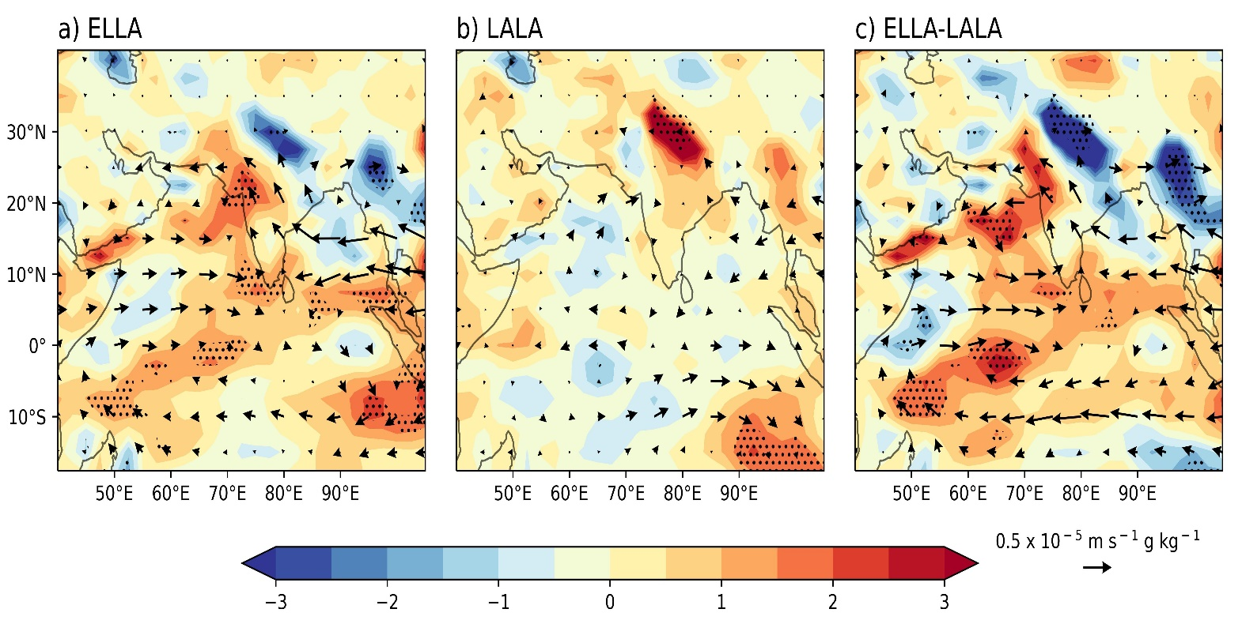
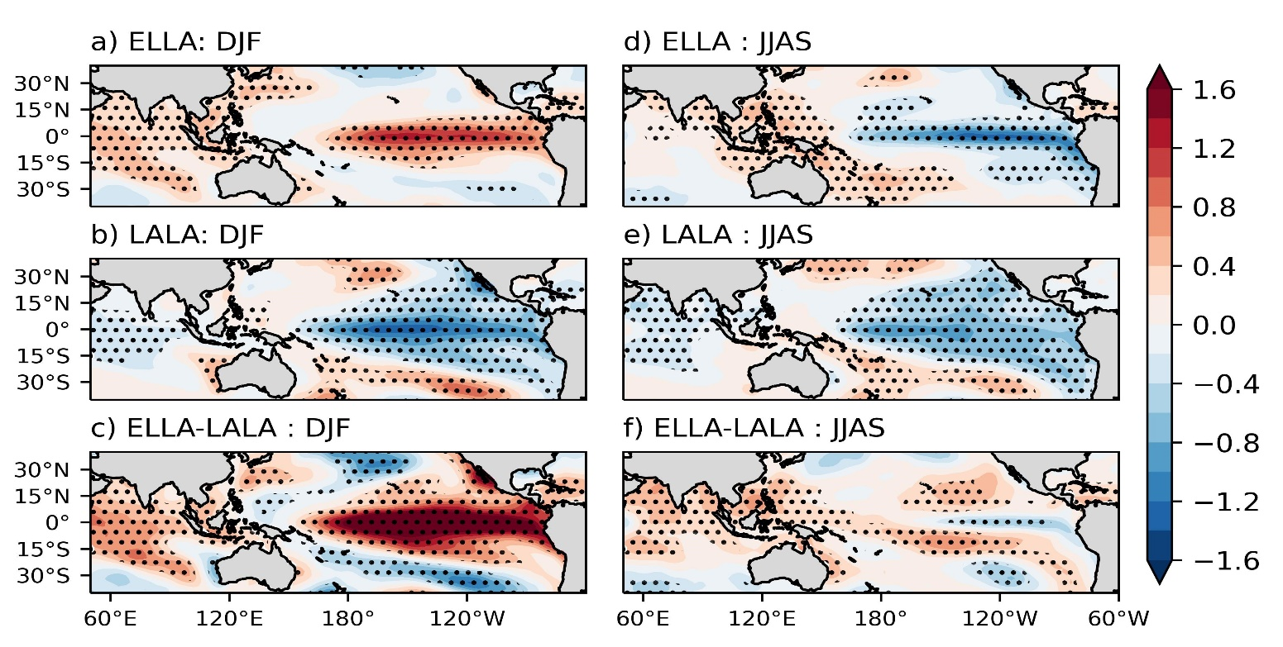
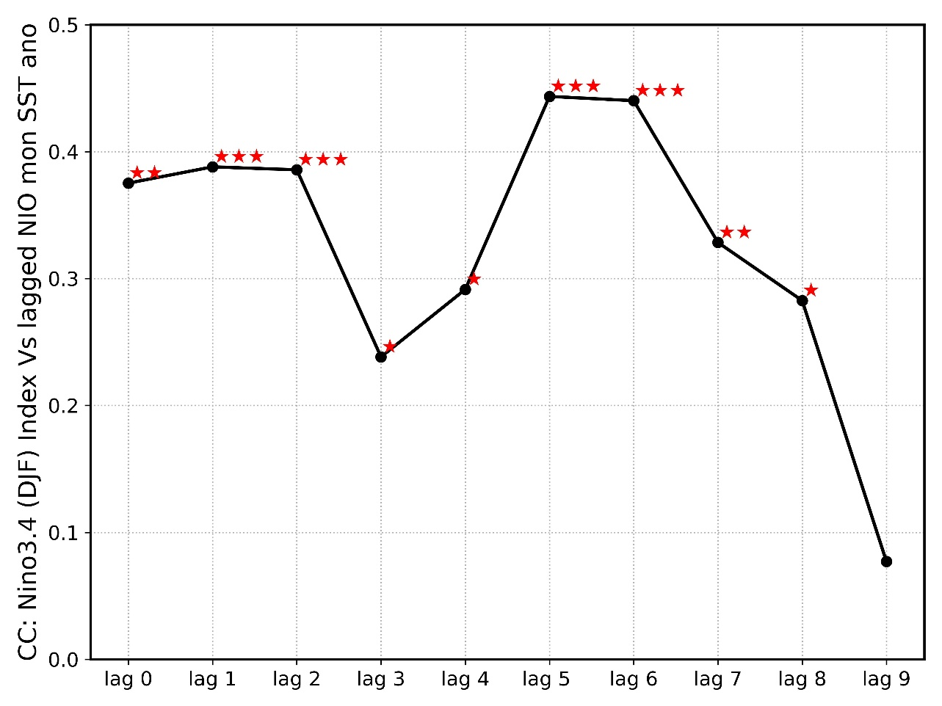
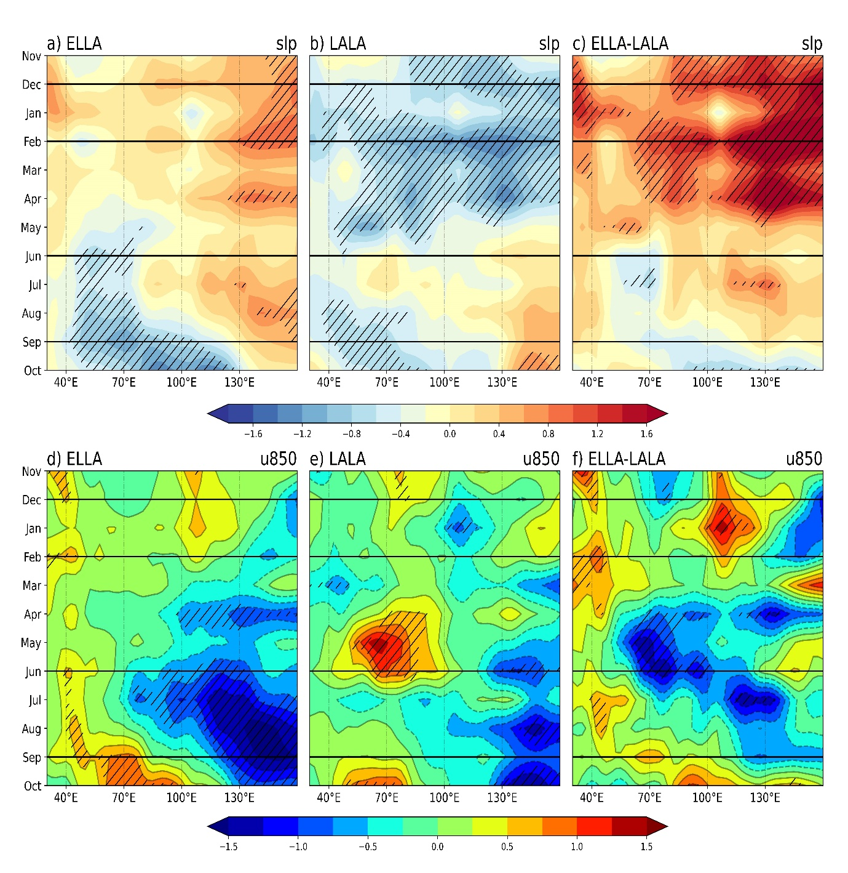
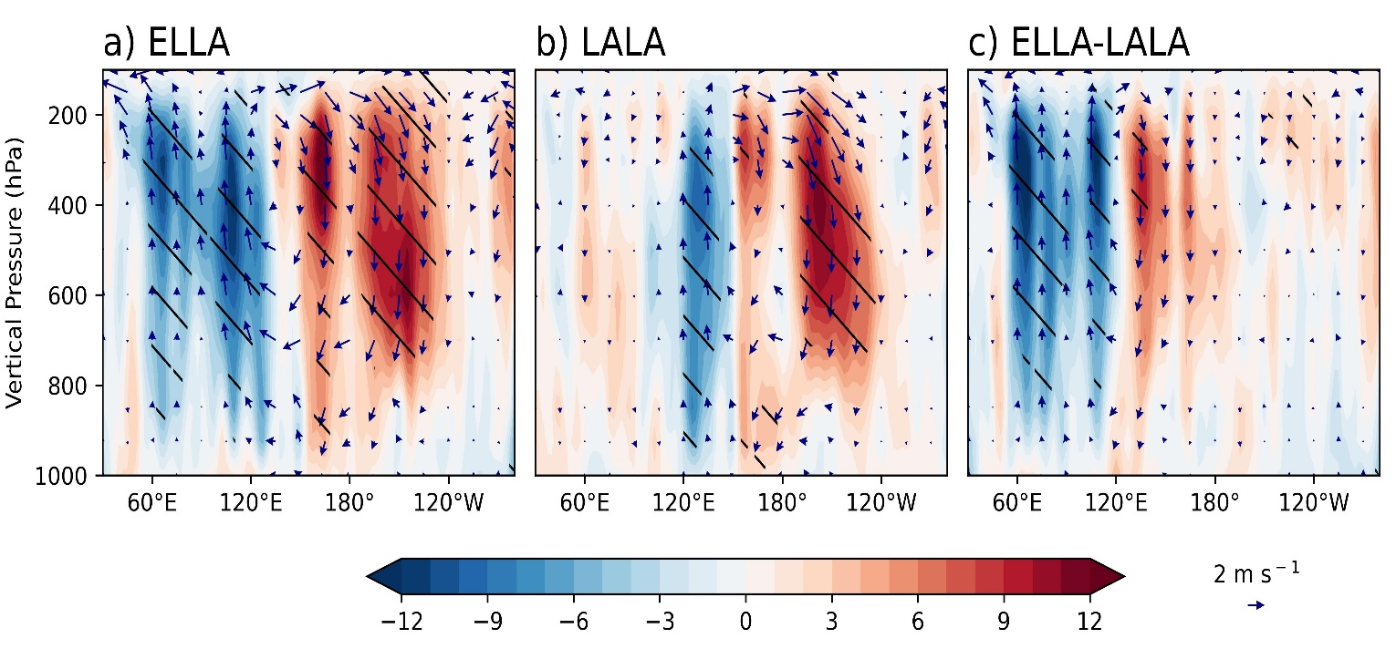
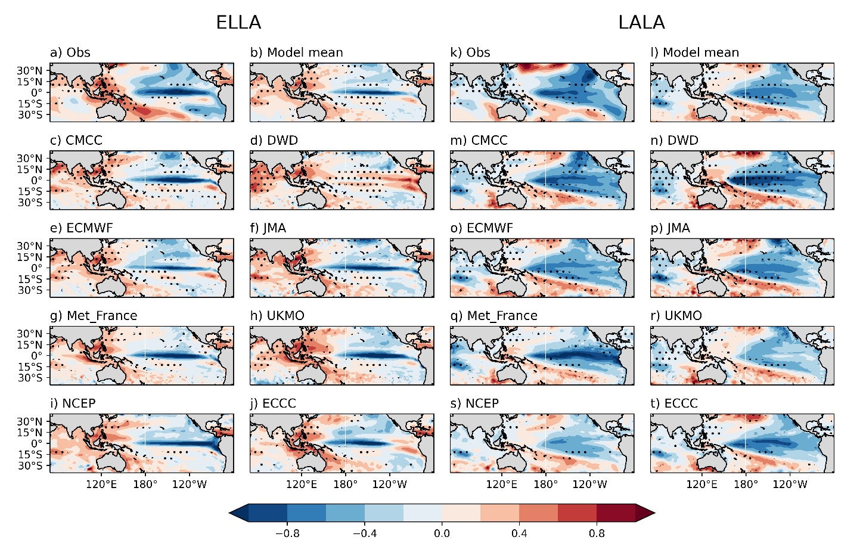
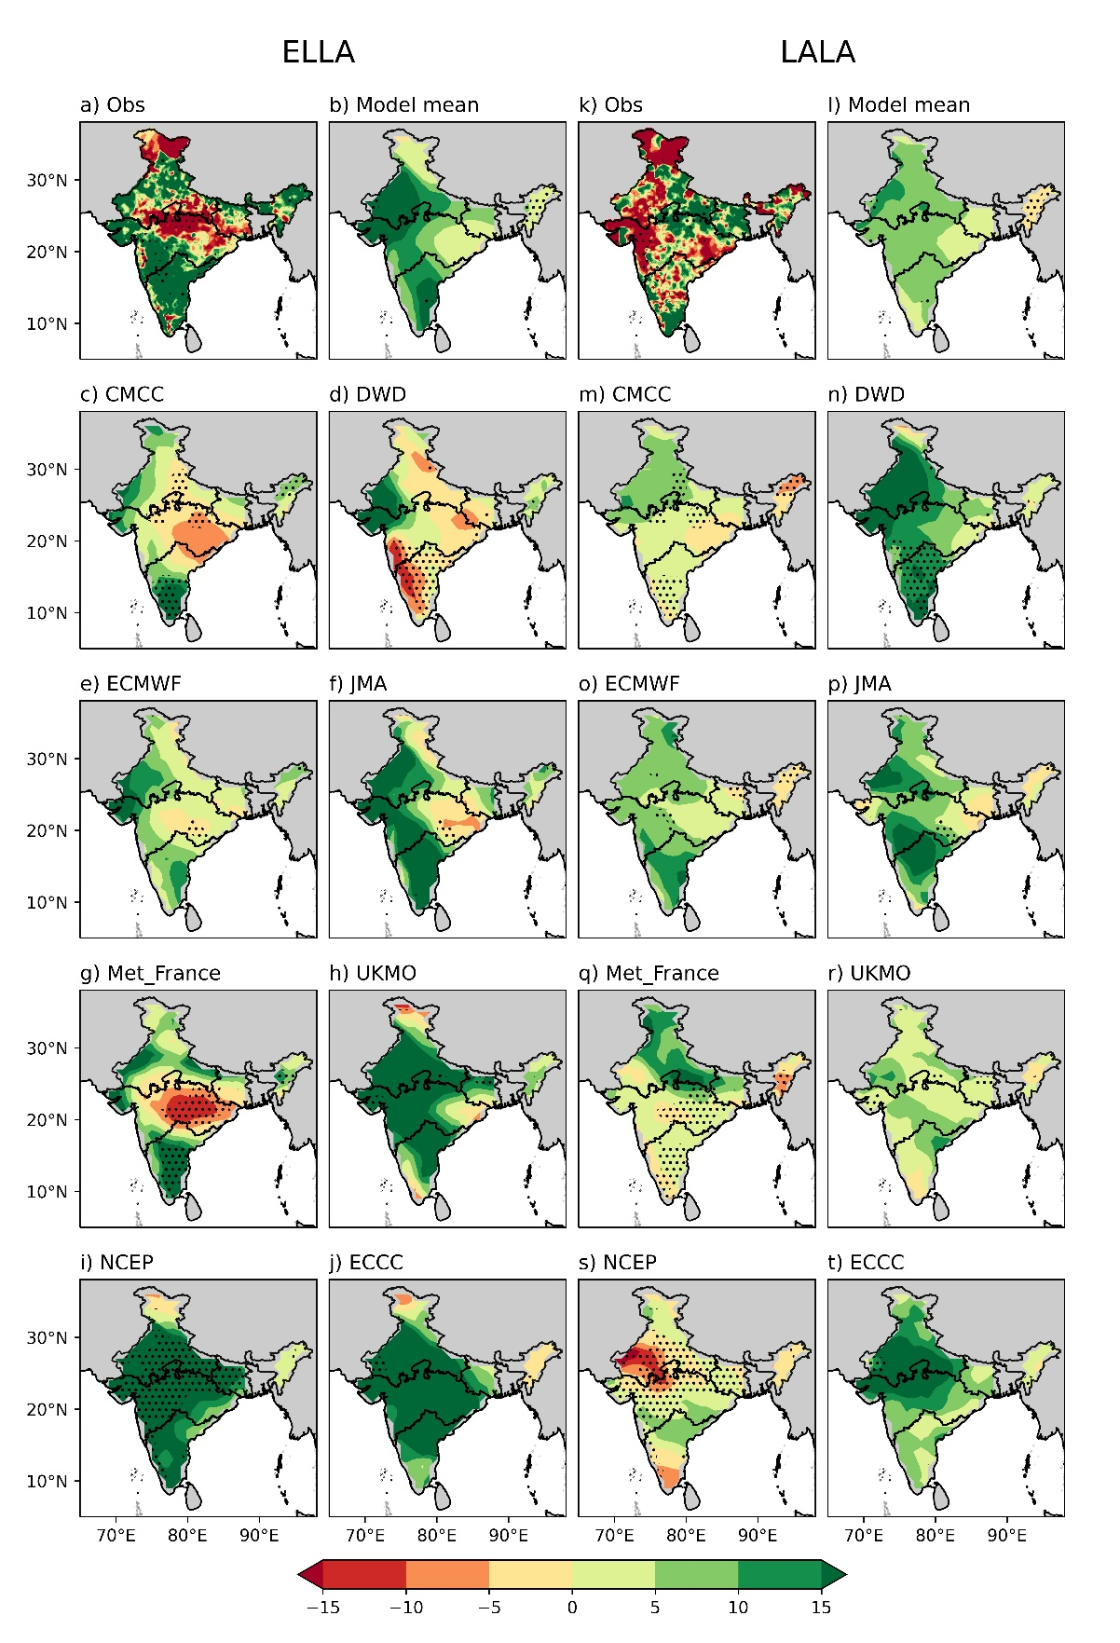
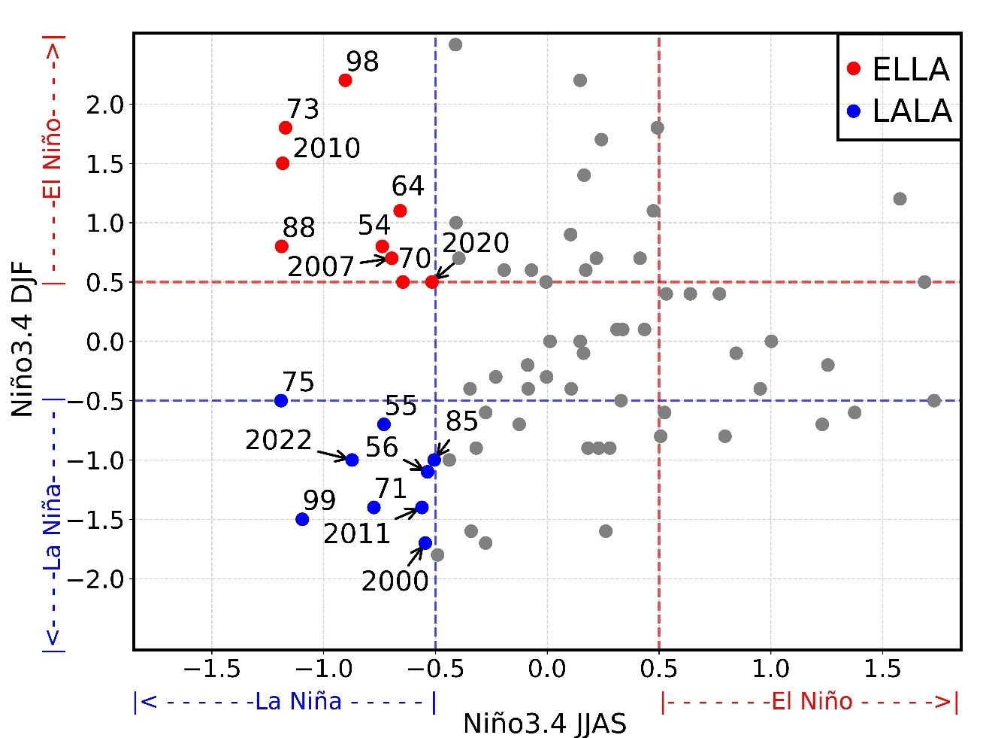
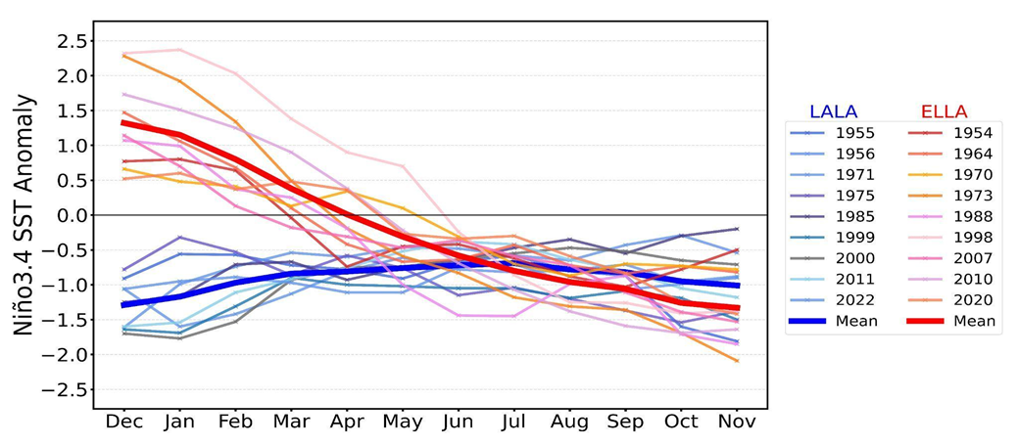
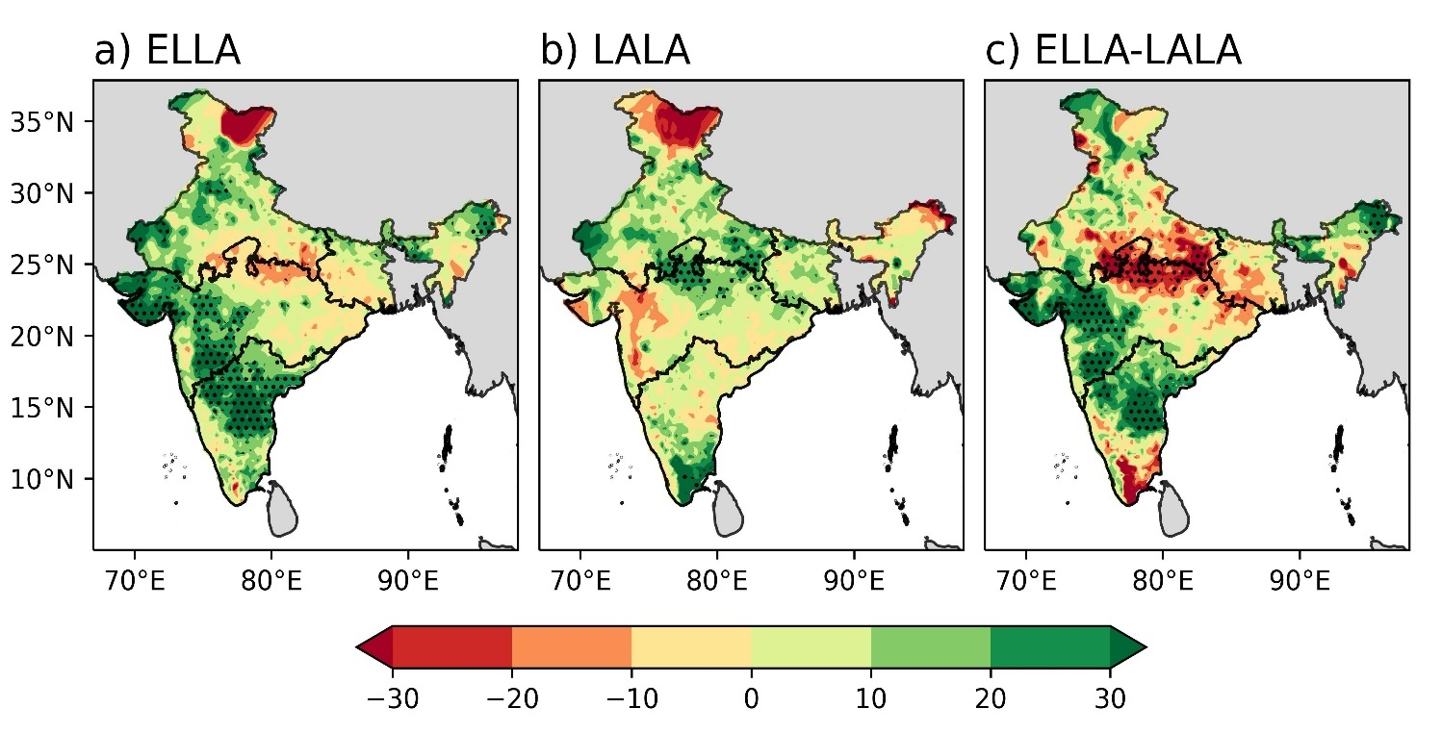
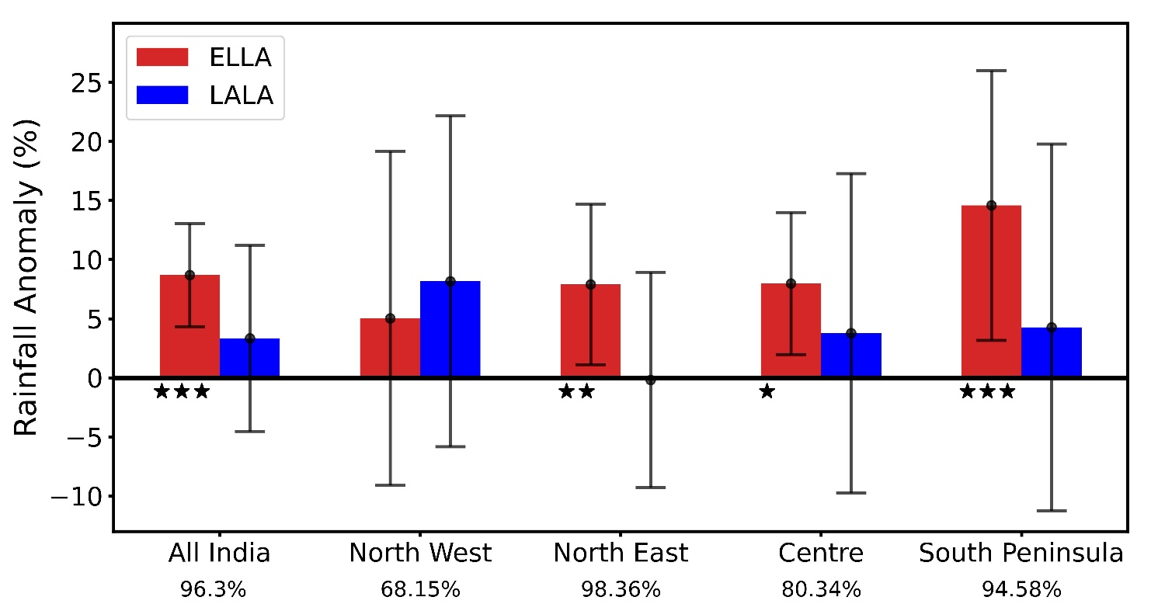
Indian Summer Monsoon Rainfall Response to Two Distinct Features of the La Niña and Performance of Seasonal Forecast Models
Tanu Sharma^{1,2*}, Satyaban B. Ratna¹, D.S. Pai³
¹ Climate Research and Services, India Meteorological Department, Pune 411005, India
² Savitribai Phule Pune University, Pune 411007, India
³ India Meteorological Department, New Delhi 110003, India
*Email: tanu35bhp@gmail.com
Introduction
Results (Cont.)
The Indian summer monsoon rainfall (ISMR) from June to September plays a significant role in India, due to its direct impact on agriculture and the economy (Gadgil and Gadgil, 2006).
El Niño-Southern Oscillation (ENSO), an ocean-atmosphere coupled system over the equatorial Pacific Ocean, is one of the drivers that strongly modulates the variability of ISMR (Kirtman & Shukla, 2000).
Apart from the influence of the Pacific Ocean, the influence of the Indian Ocean on ISMR is also important to understand (Gadgil, Vinayachandran and Francis, 2003).
Most of the studies related to ISMR define a rainfall index for India as a whole or focus only on the monsoon core zone, so the monsoon circulation over the remaining regions is not discussed in much detail (Sahoo and Yadav, 2021)
Composites of SST anomalies. Black dotted marks in a), b), d) and e): significant anomalies, black dotted marks in c) and f): significant difference between anomalies, 90% confidence level.
Vertically integrated moisture flux convergence (color contour, 10² × g m⁻² s⁻¹) and vertically integrated moisture transport (vector, m s⁻¹ g kg⁻¹) anomaly composites (JJAS season). Black dotted marks in a) and b): significant anomalies, black dotted marks in c): significant difference between anomalies, 90% confidence level.
Objective
To understand the evolution of the sea surface temperature (SST) over the Indo-Pacific region and the spatial pattern of rainfall over the four homogenous regions of India during two types of La Niña episodes and to understand the dynamics of large-scale circulation patterns.
To analyze whether the coupled climate models hindcast from Copernicus Climate Change Service (C3S) can capture the difference in the ISMR and SST over the Indo-Pacific region associated with two types of La Niña episodes.
Lagged Pearson’s correlation: SST anomaly over Nino3.4 region (DJF Season) and monthly SST anomaly over the north Indian Ocean (50°N-30°N, 50°E-70°E), 1951-2022.
Spatio-temporal evolution of sea level pressure (SLP, in hPa) and zonal wind (u, in m s⁻¹) anomaly composites (average: 5⁰N-30⁰N) over the Indian Ocean. Black hatches in a), b), d) and e): significant anomalies, black hatches in c) and f): significant difference between anomalies, 90% confidence level.
Data
***: p < 0.001, **: 0.001< p < 0.01, *: 0.01< p < 0.05
Sr. No. | DATA SET
1. | Extended reconstructed Monthly SST (ERSSTv5) (2° x 2°), (https://psl.noaa.gov/data/gridded/data.noaa.ersst.v5.html) National Oceanic and Atmospheric Administration (NOAA) (Huang et al., 2017)
2. | Monthly rainfall (0.25° x 0.25°) for Indian region prepared by India Meteorological Department (Pai et al., 2014).
3. | Monthly reanalysis-1, horizontal wind velocity (u and v), vertical wind velocity (omega), sea level pressure (SLP), specific humidity, surface pressure (2.5° x 2.5°), (https://psl.noaa.gov/data/gridded/data.ncep.reanalysis.html) National Centers for Environmental Prediction-National Center for Atmospheric Research (NCEP-NCAR), NOAA (Kalnay et al., 1996)
4. | The seasonal forecast monthly data for SST and precipitation (from June to September) by European Union Copernicus Climate Change Service (C3S), April initial condition, period 1993-2016. (https://cds.climate.copernicus.eu/cdsapp#!/dataset/seasonal-monthly-single-levels?tab=form)
Walker circulation anomalies over the Indo-Pacific region (JJAS season), 1000 hPa-100 hPa pressure level. The vector shows zonal (u) and vertical (w) wind components (values are averaged over latitude from 10⁰S to 10⁰N). Color contour: w × 10³ m s⁻¹. Black hatches in a) and b): significant anomalies, black hatches in c): significant difference between anomalies, 90% confidence level.
Methodology
The season during which the Niño3.4 (5°N-5°S and 120°W-170°W) SST anomaly is greater (less) than 0.5°C (-0.5°C), we defined that season as El Niño (La Niña). Based on the time evolution of Niño3.4 SST anomaly, we categorize two types of La Niña events:
1) La Niña in the JJAS season, preceded by El Niño in the DJF season, as ‘ELLA’.
2) La Niña in the JJAS season, preceded by La Niña in the DJF season, as ‘LALA’.
The composite anomaly analysis and the spatio-temporal evolution of the monthly anomalies of various atmospheric and oceanic fields for ELLA and LALA episodes.
The x and y components of the vertically integrated moisture transport (VIMT) are calculated from surface to 300 hPa atmospheric pressure level using the formula:-
VIMTₓ = $−\int_{300 hPa}^{Sfc}{}\frac{(qu)dp}{g}$
VIMT_{y} = $−\int_{300 hPa}^{Sfc}{}\frac{(qv)dp}{g}$
q: specific humidity, u(v): zonal (meridional) component of the wind velocity, p: pressure,
g: acceleration due to gravity.
The statistical significance of the anomalies and the difference between the anomalies is identified based on the two tailed Student’s t-test.
Composites of SST anomalies (JJAS season). Dotted marks: significant difference between anomalies, 90% confidence level.
Percentage seasonal rainfall anomaly (JJAS) composites. Dotted marks: significant difference between anomalies, 90% confidence level.
Conclusion
Results
India receives more (less) rainfall during ELLA (LALA) episodes.
During ELLA, persistent low-level westerlies and moisture transport favored the rainfall over south peninsula and west-central India. Whereas moisture divergence associated with anomalous lower-tropospheric anticyclone over west-north Pacific suppressed the rainfall over the Indo-Gangetic plains.
During LALA, the absence of westerlies and weak moisture transport subdued the rainfall over south peninsula and west-central India. At the same time, moisture convergence favored the rainfall over north-west India.
ELLA: almost all the models capture the spatial distribution of La Niña similar to the observation, except DWD and ECCC. Over north IO, a significantly positive SST anomaly is found similar to the observation in all the models except for NCEP and ECCC.
LALA: all the models capture the spatial distribution of La Niña and negative SST anomaly over the north IO.
ELLA: CMCC, ECMWF, JMA and Met_France captured the dipole-like spatial distribution of ISMR.
LALA: CMCC and Met_France capture rainfall distribution like observation, rest of the models couldn’t capture it correctly.
Niño3.4 Index for JJAS season (along the x-axis) preceding winter (DJF) season (along the y-axis) period: 1951-2022. The blue (red) dot: La Niña in JJAS season preceded by La Niña (El Niño) in the DJF season.
Niño3.4 monthly SST anomaly for ELLA (La Niña preceded by El Niño) and LALA (La Niña preceded by La Niña),1951-2022. The mean values for ELLA and LALA years are represented by red and blue bold lines, respectively.
References
Gadgil, S. and Gadgil, S. (2006) ‘The Indian monsoon, GDP and agriculture’ Econ Political Wkly, 41, pp. 4887–4895.
Gadgil, S., Vinayachandran, P.N. and Francis, P.A. (2003) ‘Droughts of the Indian summer monsoon: Role of clouds over the Indian Ocean’, Current Science, 85(12), pp. 1713–1719.
Huang, B. et al. (2017) ‘Extended Reconstructed Sea Surface Temperature, Version 5 (ERSSTv5): Upgrades, Validations, and Intercomparisons’, Journal of Climate, 30(20), pp. 8179–8205.
Kalnay, E. et al. (1996) ‘The NCEP/NCAR 40-Year Reanalysis Project’, Bulletin of the American Meteorological Society, 77(3), pp. 437–472.
Kirtman, B., and Shukla, J. (2000) ‘Influence of the Indian summer monsoon on ENSO’ Quart. J. Roy. Meteor. Soc, 126, pp. 213–239.
Pai, D.S. et al. (2014) ‘Development of a new high spatial resolution (0.25° × 0.25°) long period (1901-2010) daily gridded rainfall data set over India and its comparison with existing data sets over the region’, MAUSAM, 65(1), pp. 1–18.
Sahoo, M. and Yadav, R.K. (2021) ‘Role of equatorial central Pacific sea surface temperature in modulating rainfall over north India during Indian summer monsoon’, International Journal of Climatology, 41(13), pp. 6017–6030.
Percentage seasonal (JJAS) rainfall anomaly composites. Black dotted marks in a) and b) show significant anomalies, black dotted marks in c) show the significant difference between anomalies, at the 90% confidence level. Boundaries of the four homogeneous regions of India are shown on the maps.
Mean % rainfall anomaly (JJAS) for all-India and four homogenous regions. Error bars: standard deviation (sd). Star: significant anomalies (***: p < 0.01, **: p < 0.05, *: p < 0.1). Number (in %) below the bar plot: confidence level at which the difference of anomaly is significant.
Acknowledgments
Head, Climate Research & Services, India Meteorological Department, Pune.
Director General of Meteorology, India Meteorological Department, New Delhi.
MRFP Project, Ministry of Earth Sciences (MoES), Govt. of India.

