Slide 1
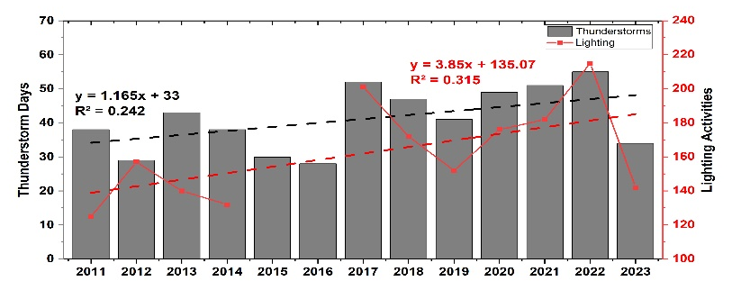
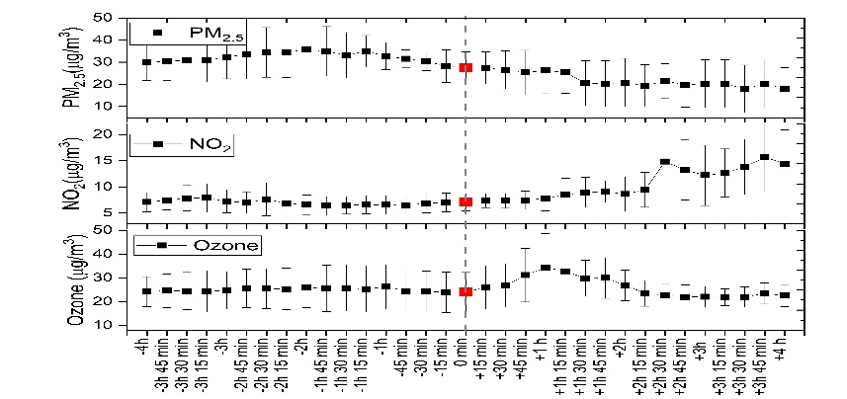
Long-term characteristics of thunderstorm activities and its influence on atmospheric composition over Bengaluru
Shaik Darga Saheb* and Chanabasanagouda S Patil
India Meteorological department, KIAL, Bengaluru
Highlights
Thunderstorm and lighting have increased significantly over Bengaluru city.
Rainfall was increasing trend while temperature was in decreasing trend over Bengaluru for the records of 13 years data.
Increasing trends in atmospheric composition like AOD, AOD, SO₂, NO₂ and O₃ based on satellite observations.
Thunderstorm affects the surface air pollutants, decrease in PM_{2.5} whereas increase in NO₂ and O₃ concentrations during thunderstorm.

