Slide 1
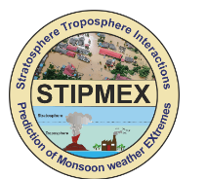
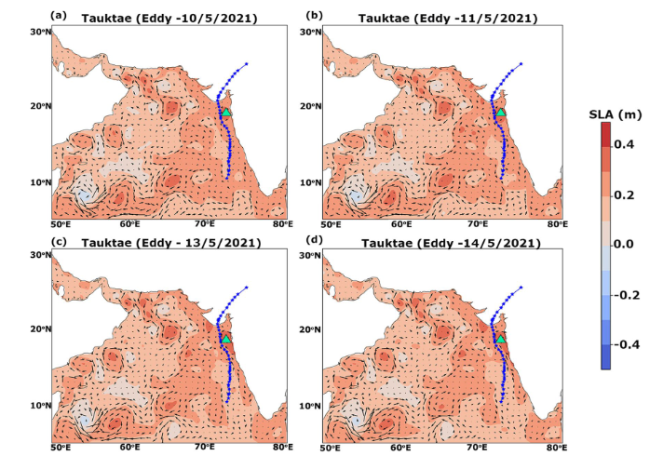
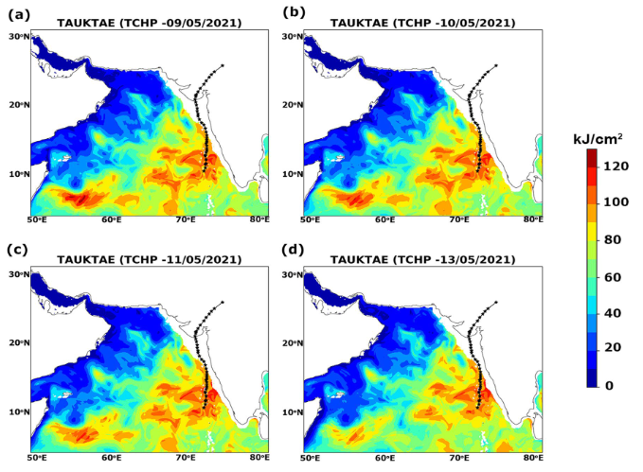
Warm Oceans and Cyclone Tauktae: Genesis and Intensification Dynamics
Athira P Ratnakaran and Abish b
Faculty of Ocean Science and Technology
Kerala University of Fisheries and Ocean Studies
athirakufos@gmail.com
Tropical cyclone ‘Tauktae’, in May 2021, was the strongest pre-monsoon cyclone that formed in the Arabian Sea.
The current study is an effort to understand the role of warm ocean conditions favorable for the genesis and intensification of extremely severe cyclonic storm ‘Tauktae’.
Very high sea surface temperature anomaly (0.8–1.6°C) and high tropical cyclone heat potential (120–140 kJ/cm²) over the cyclogenesis and intensification region.
The presence of warm core eddies was seen in the area, where the tropical cyclone had rapidly intensified from a very severe cyclone to an extremely severe cyclonic storm from 16 to 17 May 2021
High sea surface temperature, tropical cyclone heat potential, and warm-core eddies create warm ocean conditions that provided continuous energy for cyclone intensification
Ratnakaran and Abish.,2023, TAAC

