Slide 1
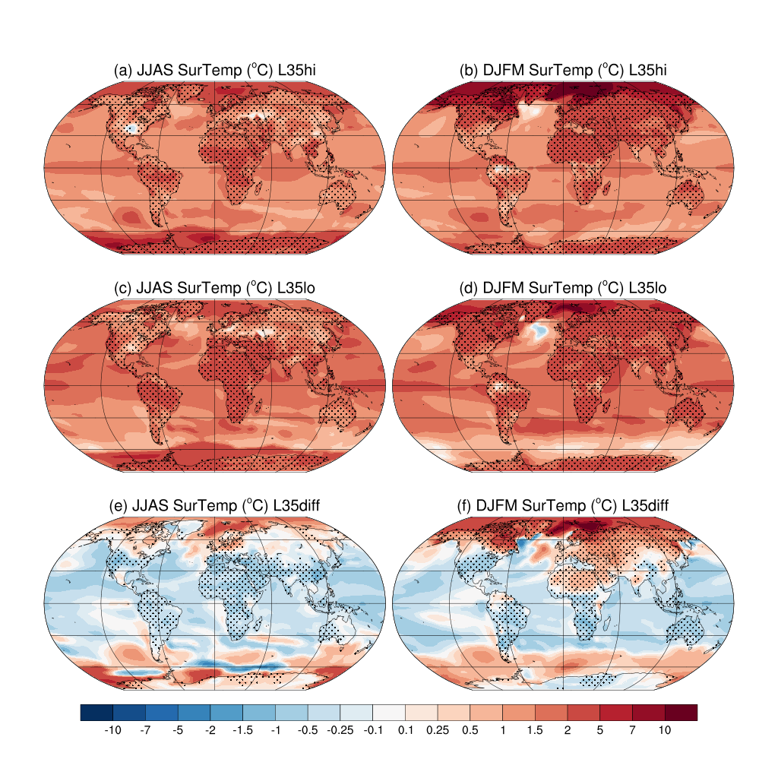
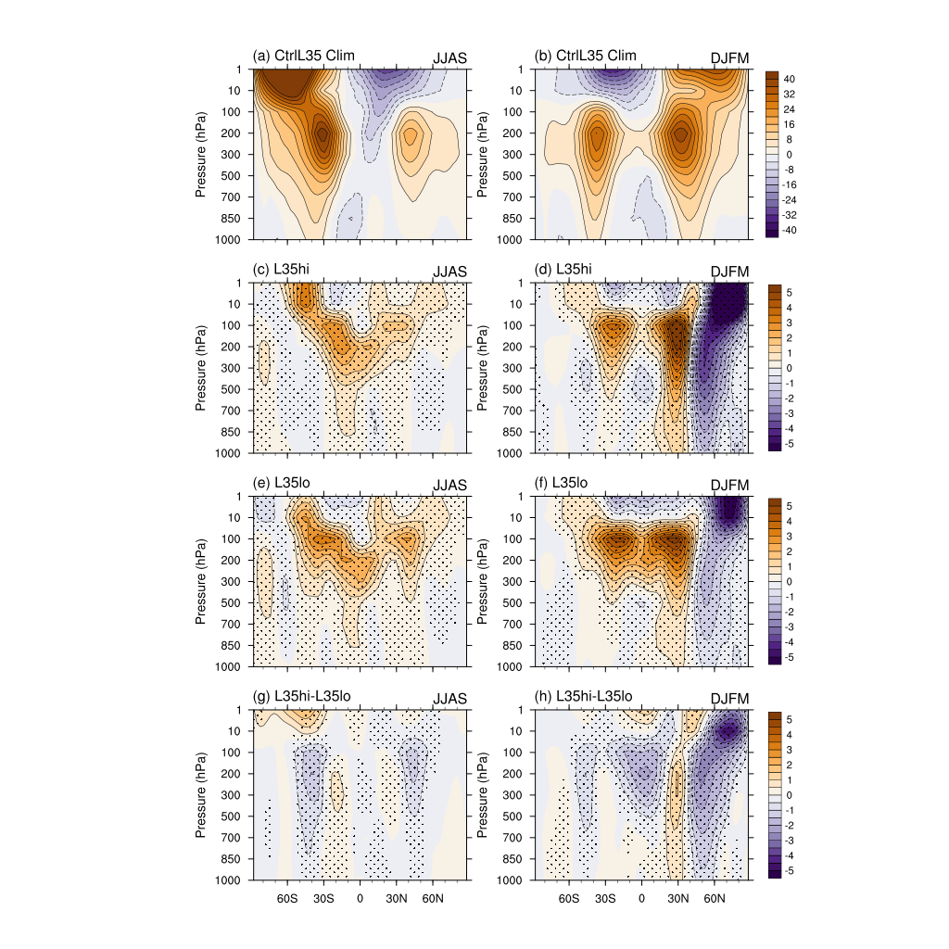
Response of low and mid latitude climate to Arctic amplification in the Intermediate General Circulation Model
Satyaban B. Ratna^{1,2*}, Timothy J. Osborn², Manoj Joshi²
¹ Climate Research and Services, India Meteorological Department, Pune, India
² Climatic Research Unit, University of East Anglia, Norwich, UK
*Email: satyaban.ratna@imd.gov.in
Introduction
Data and Methodology (2)
The rise in Arctic surface air temperatures has been almost twice as large as the global average in recent decades a feature known as ‘Arctic amplification (AA)’ (Cohen et al., 2014).
There is an increasing body of observational and modeling evidence that AA strongly impact both the weather and climate, not only in the Arctic region but also remotely in the Northern Hemisphere midlatitudes (Screen et al. 2018).
It is reported that increased concentrations of atmospheric greenhouse gases have driven Arctic and global average warming (Gillett et al., 2008).
Arctic sea ice extent is declining at an accelerating pace, and climate models project a seasonally ice-free Arctic Ocean by the middle of this century in response to increasing greenhouse gas (GHG) concentrations (Stroeve et al. 2012).
Fig 1: 21-year running mean of the annual mean Arctic surface temperature anomaly versus global mean temperature anomaly from 26 CMIP5 and 13 CMIP6 models.
Objectives
The IGCM4 (Joshi et al., 2015) was used to study the impact of projected Arctic amplification on the atmospheric circulation. The NOAA 20CRv2 (Compo et al. 2011) skin temperature for the period 1851-1900 is prescribed in the IGCM4 (T42L35) and this simulation is denoted L35ctrl.
Table 1: Model experiments and surface boundary conditions used
In this study, the impact of projected Arctic amplification on the atmospheric circulation is investigated using the Intermediate Global Circulation Model, version 4 (IGCM4; ; Joshi et al., 2015), a model with a well-resolved stratosphere. In particular, this study aims to address two key questions:
What is the response of low and mid latitude climate to Arctic warming?
Does this response depend on the degree of Arctic amplification (i.e. high and low amplification)? and
Does the stratosphere play a role in this dependence?
CTRL | High amplification | Low amplification
L35ctrl (20CR SAT) | L35hi (20CR SAT + HighAmp CMIP5 SAT) | L35lo (20CR SAT + LowAmp CMIP5 SAT)
L20ctrl (20CR SAT) | L20hi (20CR SAT + HighAmp CMIP5 SAT) | L20lo (20CR SAT + LowAmp CMIP5 SAT)
To understand the response to Arctic, two perturbation runs were conducted using composite of high amplification (L35hi) and low amplification (L35lo) surface temperature obtained from Figure 1. All other boundaries conditions were the same as in L35ctrl. The difference between the perturbed and control experiment isolates the impact of future Arctic amplification upon the atmosphere. To isolate the tropospheric pathways, another sets of control and perturbed experiments conducted using the T42L20 version of the model and the experiments are named as L20ctrl, L20high and L20low. The notation of all the SST forced experiments is given in Table 1. All the main greenhouse gases are generally prescribed using climatological data corresponding to preindustrial period. For each simulation, the model is integrated for 206 years and the mean of the last 200 years is analysed (the first 6 years are excluded to allow model spin up). We focus on the boreal summer (June-to-September) and winter (Dec-to-March) to study the Arctic response for the different parts of the globe.
Data and Methodology (1)
We have diagnosed and compared the patterns of Arctic amplification by analysing the surface temperature anomaly (TAS) from the historical simulation plus future scenario under CMIP5 and CMIP6. We have used 26 CMIP5 models for the RCP4.5 scenario of CMIP5 and 16 models under SSP2-4.5 from ScenarioMIP of CMIP6.
TAS anomaly generated for the period 1851-2100 (historical plus future scenario) with respect to 1851-1900 climatology. The Arctic amplification is defined for each model as the TAS anomaly of Arctic (north of 65 N) when the global mean surface temperature change exceeds 2 degrees C above the pre-industrial mean (1851-1900).
Results
Fig 2: Composite mean surface air temperature anomaly (⁰C) of (a) three high amplification models (b) three low amplification models (c) difference between high and low amplification models from CMIP5 simulations. The seasonal cycle of the surface air temperature anomaly area averaged over (d) Arctic, (e) tropics (20 S – 20 N), and (f) global.
Fig 3: IGCM simulated surface air temperature anomaly (C) with HighL35 and Low35 experiments and their difference, both for summer (JJAS) (a, c, e) and winter (DJFM) (b, d, f).
Fig 4: Latitude-Height cross-section of IGCM simulated JJAS zonal wind (a) climatology, (c) anomaly for HighL35, (e) anomaly for LowL35, and (g) difference between High and Low. (b, d, f, h) are same as (a, c, e, f) but for NDJF.
Fig 5: IGCM simulated latitude-height cross-section of zonal wind anomaly difference between L35 and L20 High amplification experiments both for (a) summer (JJAS) and (b) winter (DJFM). (c, d) same as (a, b) but for low amplification experiment.
Conclusion
References
High Arctic amplification CMIP5 and CMIP6 models simulate similarly enhanced warming over the Arctic, but less warming over Antarctic sea ice for CMIP6. Low amplification CMIP6 models simulate greater Arctic/Antarctic warming compared to CMIP5 models.
When the IGCM4 forced using the SST anomaly from high and low amplification models from CMIP5 models, we see that both experiments simulate significant warming throughout the globe. However, extratropical NH landmasses simulates enhanced significant warming during boreal summer as well as winter in High amplification experiment compared to Low amplification, and this is stronger and extends more southward during winter. This is coinciding with the tropospheric Jet shifts equatorward which is stronger in high amplification experiment compared to low amplification experiment.
We conducted another set of experiment to understand the role of troposphere-stratosphere coupling, by isolating the stratospheric pathway by restricting the top of the atmosphere up to tropospheric height, and found that there is no change in the position of the equatorward shift of the jet, but they have reduced in intensity.
Cohen, J., Screen, J., Furtado, J. et al. (2014) Recent Arctic amplification and extreme mid-latitude weather. Nature Geosci 7, 627–637
Screen JA, Deser C, Smith DM, et al. (2018) Consistency and discrepancy in the atmospheric response to Arctic sea-ice loss across climate models, Nature Geoscience, 11,3, 155-163.
Gillett, N., Stone, D., Stott, P. et al. (2008) Attribution of polar warming to human influence. Nature Geosci 1, 750–754.
Stroeve J C, Serreze M C, Kay J E et al., (2012) The Arctic's rapidly shrinking sea ice cover: a research synthesis Clim. Change 110 1005–27
Joshi, M., Stringer, M., van der Wiel, K., O'Callaghan, A., and Fueglistaler, S.: IGCM4: a fast, parallel and flexible intermediate climate model, Geosci. Model Dev., 8, 1157–1167
Acknowledgements
This study is supported by the Belmont Forum and JPI-Climate project INTEGRATE (An Integrated Data-Model Study of Interactions between Tropical Monsoons and Extratropical Climate Variability and Extremes) with funding by U.K. NERC Grant NE/P006809/1. The model experiments were conducted on the High Performance Compute Cluster at the University of East Anglia.

